Slide 1
CSCI 45: Pipelining Lecture
Professor Kerney

Slide 2
Agenda
Computer Organization: Pipelining
Assembly: Disassembling a Program
Assembly: Homework 3 - Locksmith
Physical Computing: Lab Time for your Projects

Slide 3
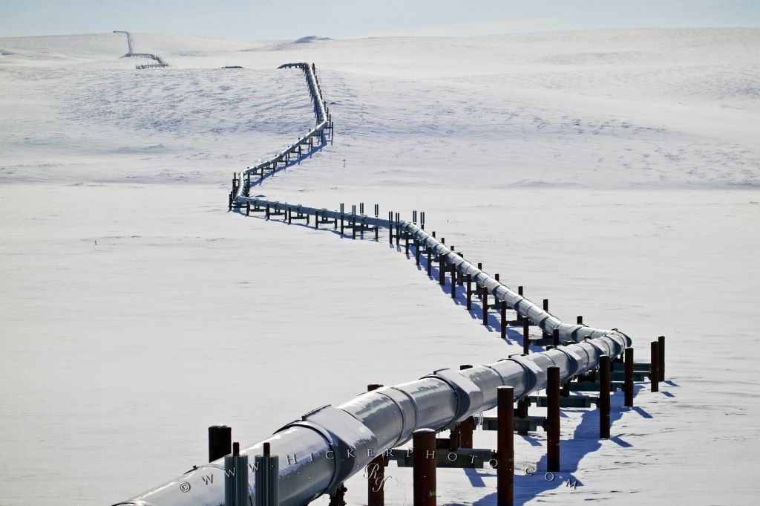
Not Our Pipelining

Slide 4

Also Not Our Pipelining

Slide 5
Pipelining
Imagine you are doing laundry with your usual pair of machines, one washer and one dryer. Cost $500+$500.
Let’s say your washing machine takes one hour
Your drying machine takes one hour.
Total time to do one load of laundry: two hours.
Suppose you were offered the ability to buy a single machine, that would do both washing and drying in a two-hour cycle, that would cost $1000.
Advantages? Disadvantages?
Would you buy it?

Slide 6
Cost/Benefit Analysis
Cost: identical
Time to do one load of laundry:
Washer & Dryer: 2 hours
Combo Machine: 2 hours
Time to do two loads of laundry:
Washer and Dryer: 3 hours
Combo Machine: 4 hours
Time to do three loads of laundry:
Washer and Dryer: 4 hours
Combo Machine: 6 hours

Slide 7
3-Stage Pipeline
Let’s add a third “stage” to this process: folding.
You could either fold your laundry yourself (which would take an hour, just to keep all the numbers even), or buy a combo machine that would spend an extra hour (after the two hour wash/dry cycle) folding your laundry.
Time to do one load of laundry:
Washer & Dryer + Folding: 3 hours
Combo Machine: 3 hours
Time to do three loads of laundry:
Washer & Dryer + Folding: 5 hours
Combo Machine: 9 hours

Slide 8
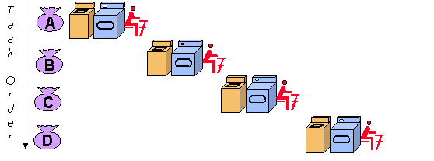
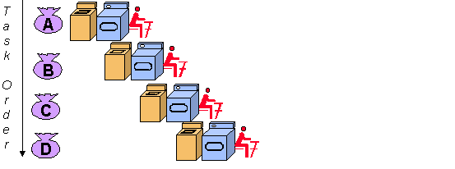
http://www.cybercomputing.co.uk/Languages/Hardware/laundryAnalogy.html

Slide 9
Benefits of Pipelining
It doesn’t make an individual task faster!
In fact, pipelining usually makes a single instruction take longer, since there’s often stages you don’t use.
Instead what you gain is throughput – the total number of tasks completed per day is much higher.
Think of it like an assembly line – you get much more productivity overall by having each station working at 100% capacity, rather than waiting for a single task to finish before starting in on the next.

Slide 10
Pipelining For Fun and Profit
Even up the rows
Person on the furthest right (my right) writes his name on a piece of paper and passes it to the left (your right)
Next person will rotate the paper 90 degrees and do the same.
Person at the far left (my left, your right), after writing her name, will shout “next!” and repeat 10 times.
Time it.
Do it again, this time the second person will shout “next!” and the first person will issue another paper immediately. Compare the times.

Slide 11
A Classic RISC Pipeline
This is the three-stage pipeline described in the textbook, which was only true in the early ARM days:
Fetch: grab the next instruction from memory
Decode: figure out what it means
Execute: run the command
The reality is a lot more complicated, with our RPis having an 8 stage pipeline, and others having + or -.
Homework Assignment: Bing five different sorts of CPU chips (Intel, ARM, ATMega, etc.), and report to me how deep their pipeline is (if they have different pipelines, then to do a simple addition statement).

Slide 12
Bubbles in the Pipeline
There’s two main downsides to a pipeline:
The first is called a Stall (or Bubble) in the pipeline
If I have commands like this:
ADD R0, R0, R1
ADD R1, R0, R1
I can’t execute the second command until the first finishes (“commits”) out of the pipeline, because the next instruction is dependent on the first. So I have to NOP until it is ready.
This makes our pipelines a lot less efficient.

Slide 13
Out of Order Execution
Smart compilers that know the pipeline sizes of their chips will move these sorts of instructions around if they can to avoid data dependencies in commands executing at the same time in the pipeline.
Out of Order Execution / Instruction Reordering: Higher end CPUs also reorder instructions to avoid bubbles. For example if you’ve got a bunch of unrelated other stuff you could be doing, it’ll execute those before the second ADD.
The ARMv7 (ARM Cortex A7) does not do instruction reordering, but the Cortex A9 does.
This is a huge area of research

Slide 14
Flushing the Pipeline
There’s two main downsides to a pipeline:
The second is called a pipeline flush
If I have commands like this:
ADDS R0, R0, R1
BGT some_label
BAL some_other_label
If the CPU is fetching one command at a time, it has a troubling choice to make – which function should it fetch next? The instruction at some_label or some_other_label?
If you guess wrong (and you don’t find out you’re wrong until the previous statement finishes), your whole pipeline is invalid and has to be flushed out
The penalty is equal to your pipeline depth. (8 cycles on a RPi 2.)

Slide 15
Branch Prediction
Since the penalty for guessing is so steep, a lot of research has gone into being able to intelligently guess which way a branch will be taken, to avoid a flush.
Some are as simple as remembering the last way you went when you got there, but there’s a lot more complicated options as well.
All this falls under the category of “branch prediction”.

Slide 16
Locksmith
Look in your ~locksmith directory

Slide 17
Lab Time

